Slide 1

Network Protocol Analyzers
Comparison of tools and use case

Slide 2

Contents
Protocol Analyzers and uses cases
Wireshark vs tcpdump
1
How it works
2
Protocol Analyzers
3
Use Case
4
Conclusion

Slide 3
Overview
Network protocols
Data get captured and analyzed by sniffing them on Layer 1 – wire level
A process of encapsulation – decapsulation as OSI Models describes occurs
Protocol Analyzers
Wireshark
tcpdump
Use Case
Problem breakdown approach
Bottom-up
Narrowing the scope
Lessons & Answers

Slide 4
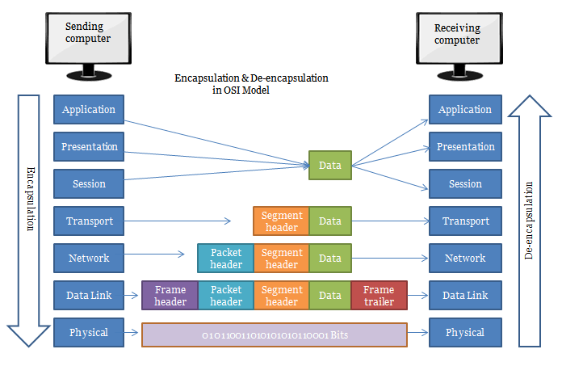
OSI de-encapsulation process

Slide 5
Wireshark vs tcpdump
Criteria | Wireshark | tcpdump
Open-Source | + | +
Easy to use | + | -
Easy to Learn | + | -
Packet Identification analysis & decode | + | -
Efficiency decoding | + | -
Fast setup on the host | + | +
Filters | + | -
Network Interfaces | + | -
Cross-Compatibility | + | -
Flexibility on using live | + | +
Troubleshooting | + | +
Data capture abilities | + | +
Industry Standard | + | +
Product & Community Support | + | +

Slide 6

Wireshark vs tcpdump
It is not about the percentage. It is all about use case and infrastructure
Open-Source
Fast setup on the host
Open-Source
Capture then use on Wireshark
Easy to Learn
CLI
Easy to use
Data capture abilities

Slide 7
Use cases
Network traffic analysis for statistics
Data analysis capture for decryption
Sniffing
troubleshooting
monitoring
And many much more

Slide 8
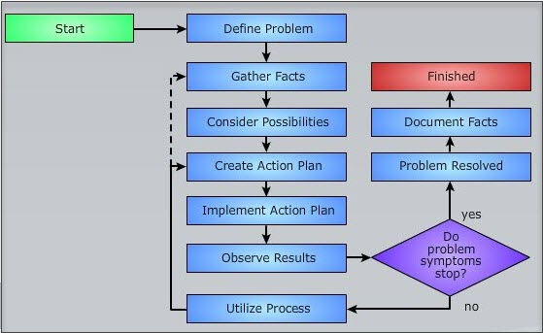
Use cases
Wireshark main use case follows simple
rules of problem solving

Slide 9
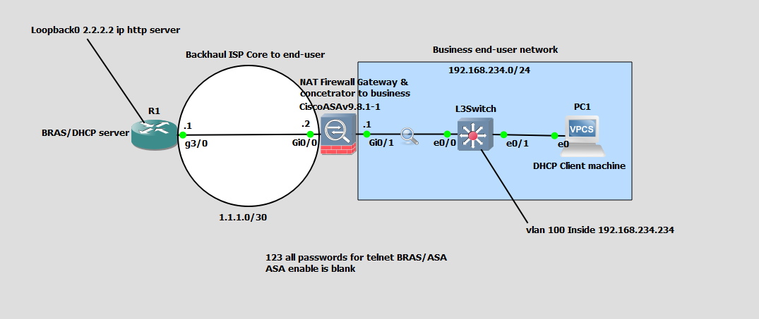
Use cases scenario
A network where DHCP process had DO without RA

Slide 10
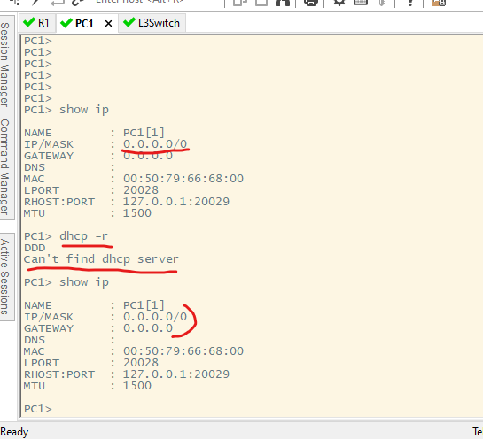
Use cases scenario
Clients’s PC unable to get DHCP offer

Slide 11
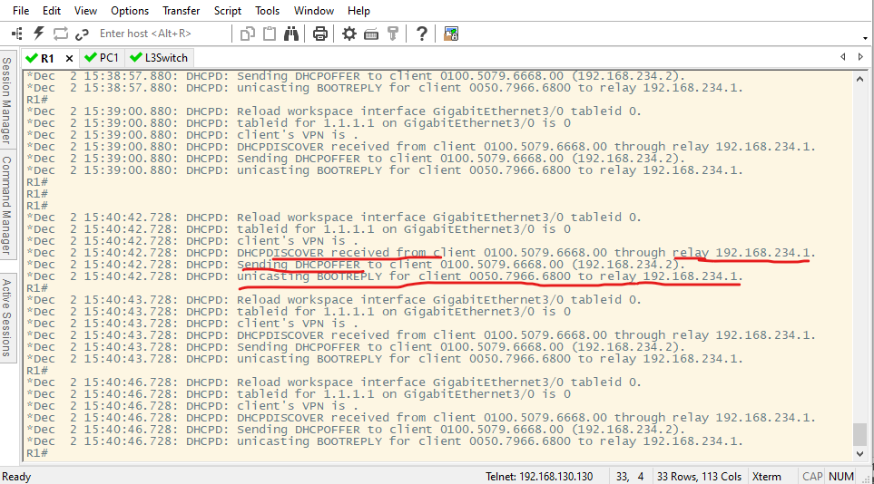
Use cases scenario
Server Logs shows that communication is ok
Up to a point

Slide 12
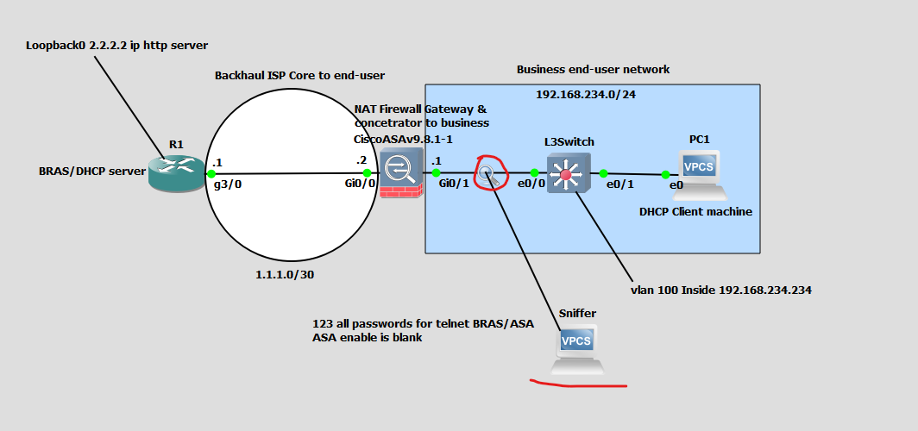
Use cases scenario
Sniffing traffic by following the flow of the packet

Slide 13
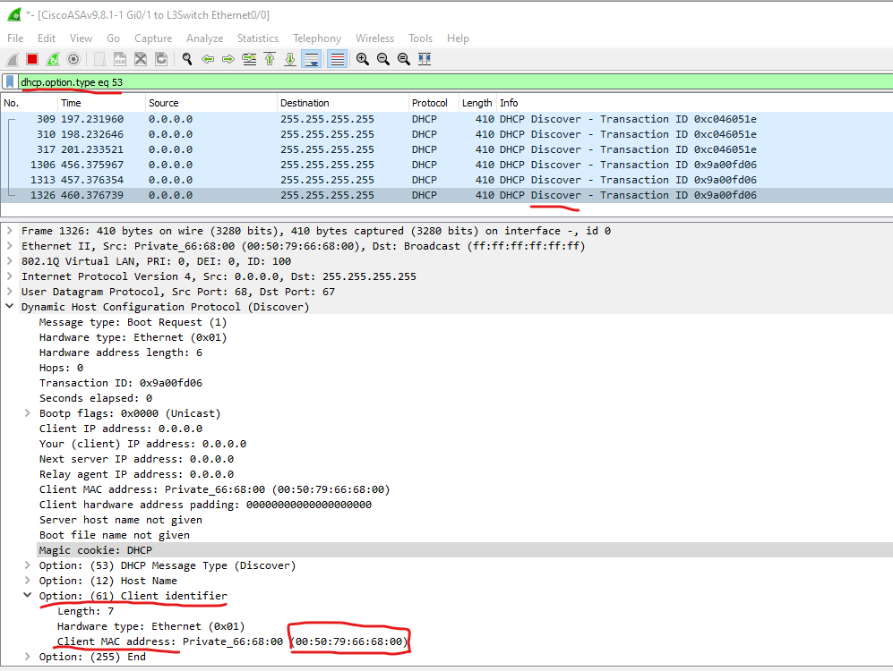
Use cases scenario
Sniffing traffic by following the flow of the packet

Slide 14
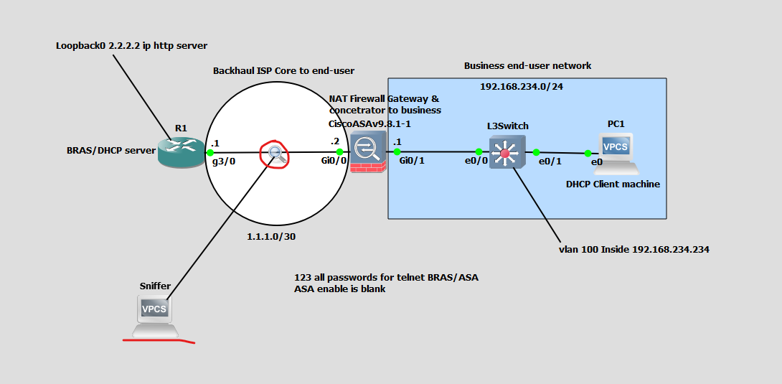
Use cases scenario
Sniffing traffic by following the flow of the packet
In each segment
port forwarding the traffic and capture with Wireshark on top of WAN backhaul

Slide 15
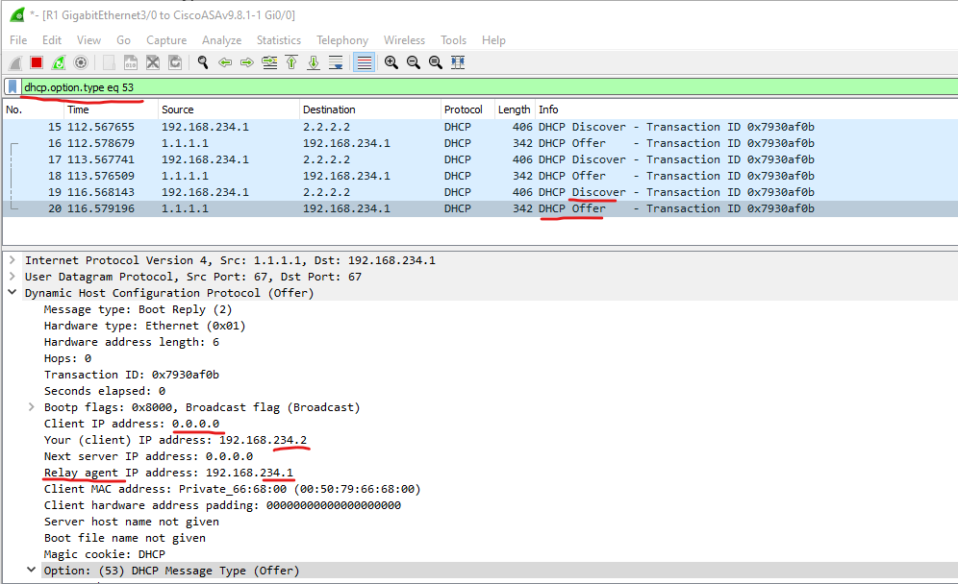
Use cases scenario
Sniffing traffic by following the flow of the packet
In each segment

Slide 16
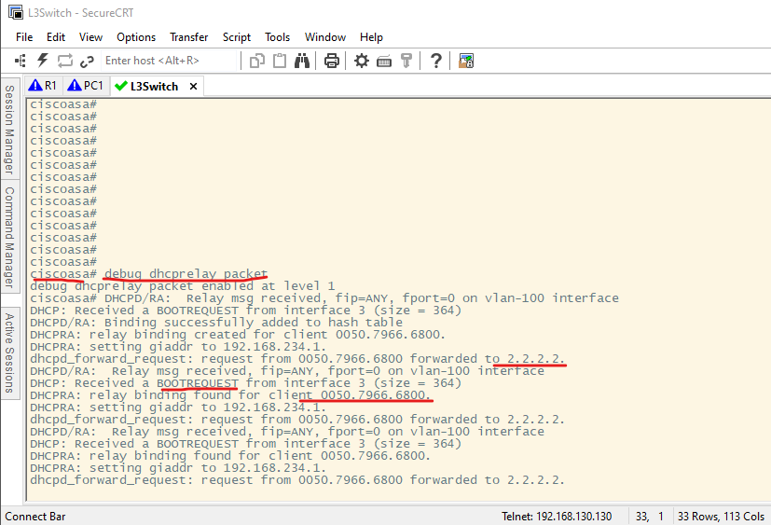
Use cases scenario
Main Firewall debug troubleshooting

Slide 17
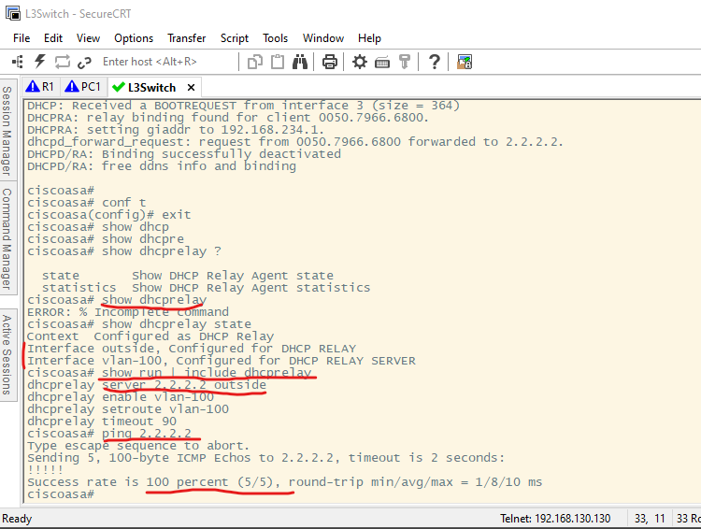
Use cases scenario
Firewall can reach DHCP server thought

Slide 18
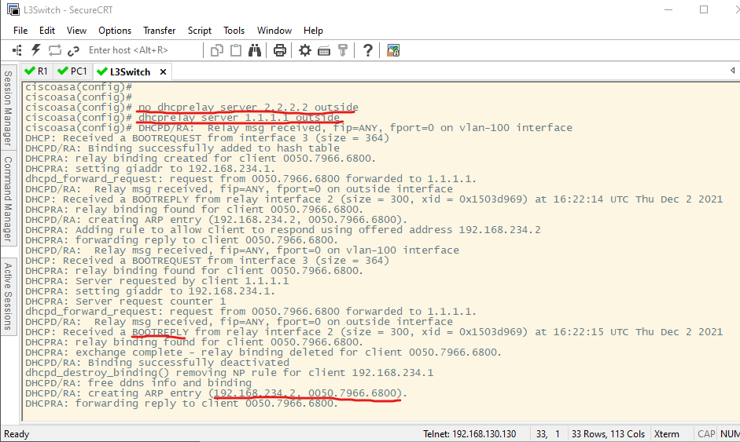
Use cases scenario
Misconfiguration of IP despite that was legit
(It could be reached)

Slide 19
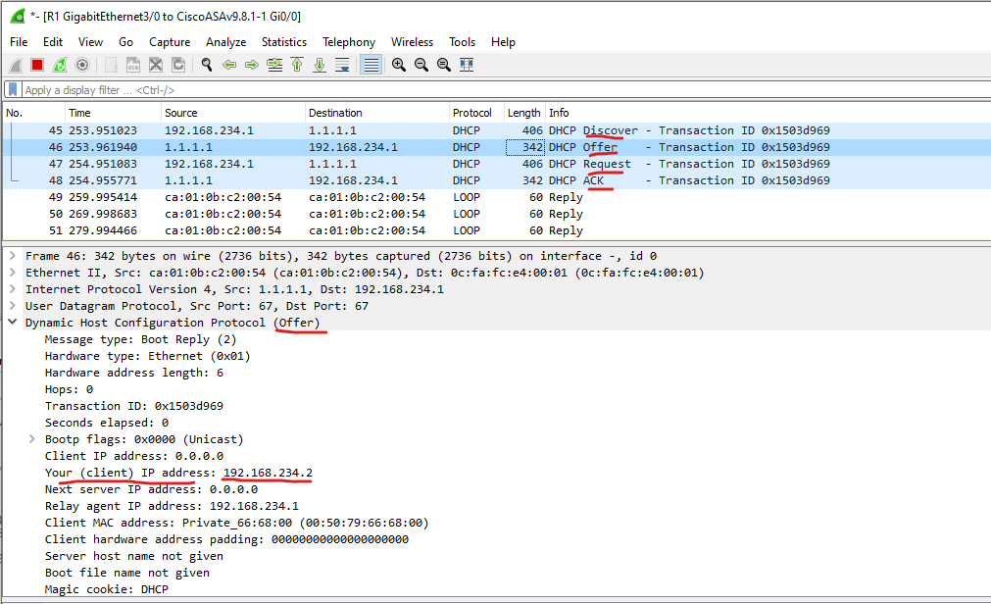
Use cases scenario
DORA SUCCESS

Slide 20
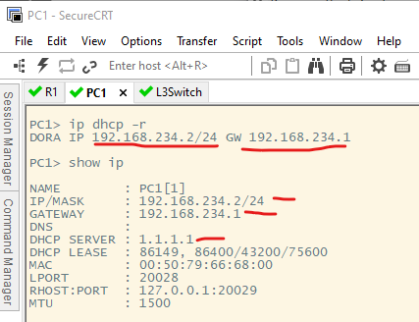
Use cases scenario
DORA SUCCESS

Slide 21
Conclusion
To Use a tool
Its about current infrastructure and design possibilities
To solve a problem
To understand a problem first we understand the application tier error then the network.
Doesn’t matter how big the network is, cut it up into chunks until you close in on the issue, it is like a shortest-route path algorithm logic, actually, this is exactly how an algorithm will work its way through the solution e.g., make neighbours, many times the same way we use to solves agnostic problems.
Trace the problem with appropriate methodology applied e.g., bottom top in OSI/TCP-IP layer [13].
Log the first point of failure
Log the Last Point of failure
Repeat
Wireshark is your friend
Common Logic behavior for problem solving.

Slide 22
Thank You!

